Slide 1
Implementation of Multi-Tenant Environment in cloud computing

Slide 2

Definition
The introduction of cloud computing has allowed applications to run on shared resources. As a result, the hosting world become subject to economies of scale. This model contrasts with traditional software approaches, where each grouping of customers is hosted on their own customized application and database instances. Multi-tenancy promotes sharing of resources all the way from a single application instance to the database. All the while, providing increased maintainability, scalability and reducing hosting costs. This thesis attempts to create an architecture description that addresses the design concerns related to the implementation of a multi-tenant that utilizes Microsoft Azure.

Slide 3

Mission statement 1: In-Memory Database Management System

Slide 4
What is IMDBMS??
An in-memory database (IMDB) stores computer data in a computer’s main memory instead of a disk drive to produce quicker response times. Accessing data stored in memory eliminates the time needed to query data from a disk.

Slide 5
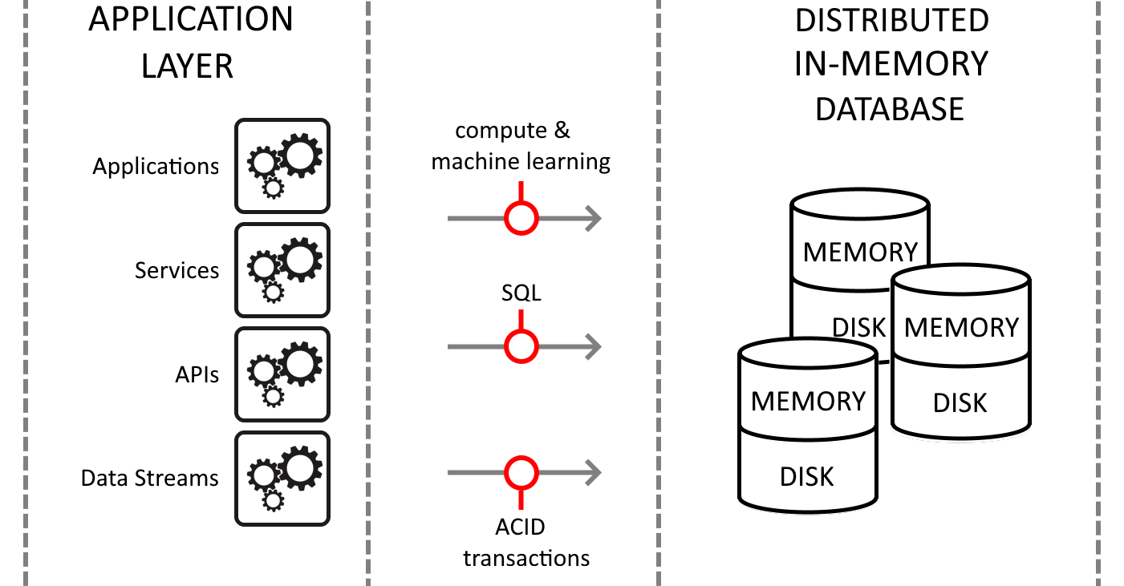

Slide 6
How does In-Memory Database work?
Stored in RAM or Main memory
Virtual Data Compression
Direct navigation from index to row or columns

Slide 7
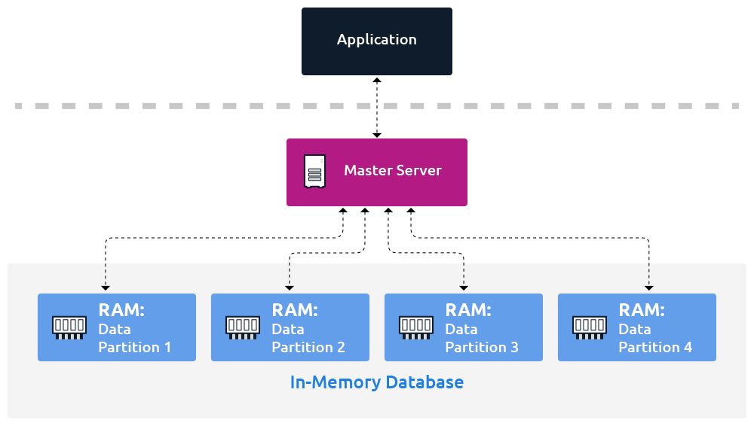

Slide 8
Why use In-Memory Database?
Faster Transaction
No translation
Multi-user concurrency

Slide 9
In-Memory vs Traditional Database
An IMDB keeps all data in main memory or RAM whereas Traditional DB retrieves data from disk drives.
IMDBs are more faster and volatile than Traditional DBs.
IMDBs allows real-time analysis and reporting data.
In IMDBs, different parts of database are managed using direct pointers but in Traditional DBs, different block must be read from disk.

Slide 10
Properties of IMDBMS
Atomicity
Consistency
Isolation
Durability

Slide 11
Simpler and Executes fewer instructions
Advantages of IMDBMS
Remotely usable
Reduces memory consumption

Slide 12
Virtual Memory Compression
Virtual memory compression (also referred to as RAM compression and memory compression) is a memory management technique that utilizes data compression to reduce the size or number of paging requests to and from the auxiliary storage.

Slide 13
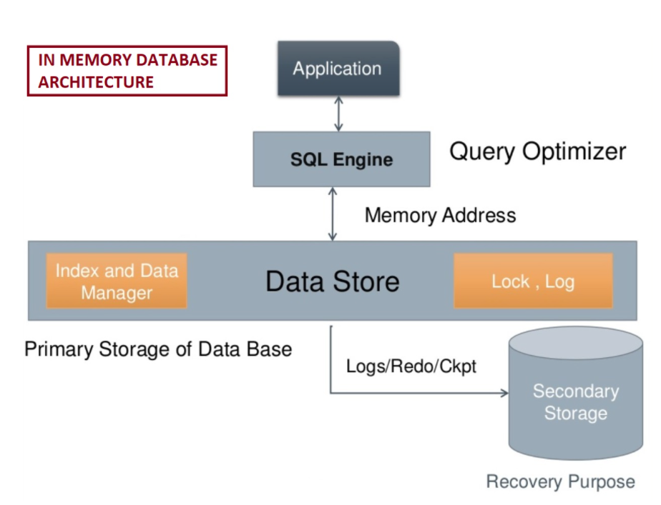

Slide 14
Features Supported in Oracle TimesTen
“Satisfy your need for speed”
Fastest OLTP based Software
Fast response time
Provides standard relational database APIs and interfaces
Database connectivity
Notes:
Yash

Slide 15
Features available in Gridgain
Apache Ignite was originally contributed to the Apache Software Foundation by GridGain Systems.
Financial trading systems
Online gaming
Bioinformatics
Hyperlocal advertising
Cognitive computing
Geospatial analysis
Notes:
Nidhi

Slide 16
Features of Sap Hana In-Memory Database
Sap Hana is hybrid In-memory database.
It uses parallel processing with multicore CPU Architecture.
Sap Hana in-memory reads data in 5 nanoseconds where in conventional database, it takes 5 milliseconds
Notes:
Srishu

Slide 17
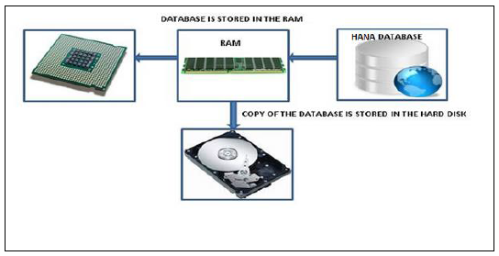
Notes:
Srishu

Slide 18
Mission statement 2: Multi-tenancy

Slide 19
Multitenancy
Multitenancy is a crucial component of cloud computing; without it, cloud services would be far less practical. Multitenant architecture is a feature in many types of public cloud computing

Slide 20
Benefits of Multi Tenancy
Better use of resources
Lower Costs
Increased Efficiency

Slide 21
Drawbacks of Multi Tenancy
Possible security risks and compliance issues
The "noisy neighbor" effect

Slide 22
In public cloud computing
Working of Multi tenancy
In container architecture
In serverless computing
In private cloud computing

Slide 23
IMDBS on AWS

Slide 24
Case : Amazon ElastiCache
How does it work?
Amazon ElastiCache is a fully managed, in-memory caching service supporting flexible, real-time use cases. You can use ElastiCache for caching, which accelerates application and database performance, or as a primary data store for use cases that don't require durability like session stores, gaming leaderboards, streaming, and analytics. ElastiCache is compatible with Redis and Memcached.

Slide 25
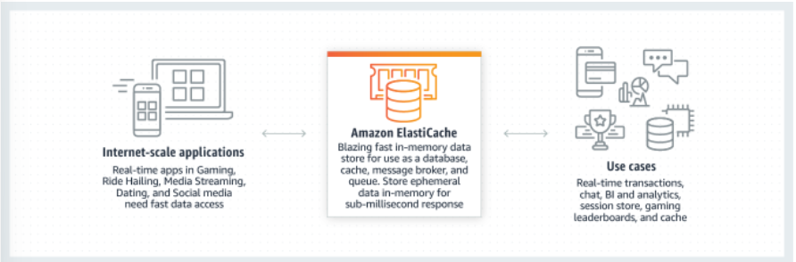

Slide 26
Use Cases
Build low-latency data stores
Accelerate application performance
Ease backend database load

Slide 27
Disk-based Queries vs Inmemory based Queries

Slide 28
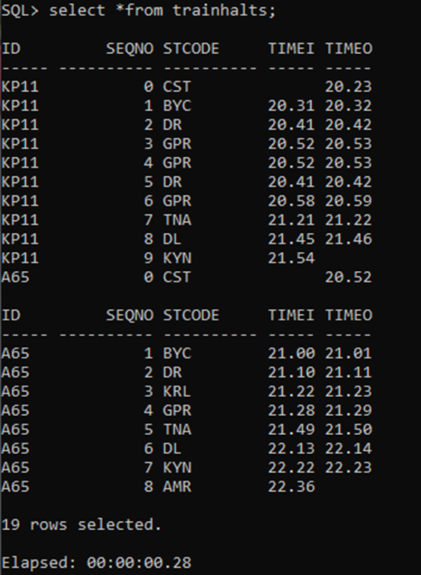
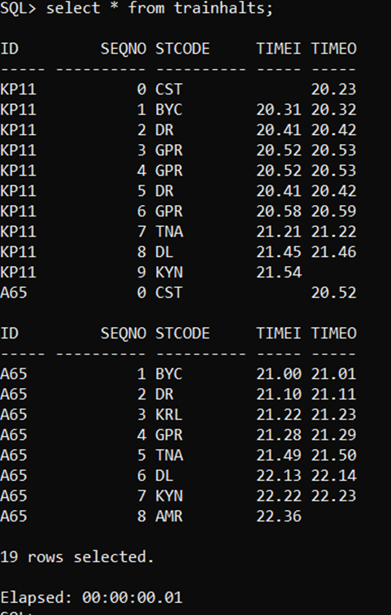

Slide 29
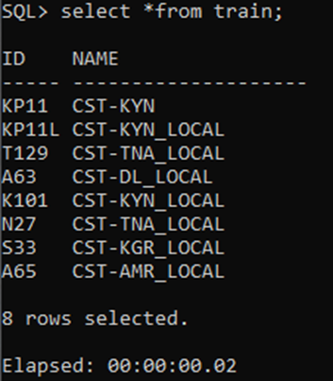
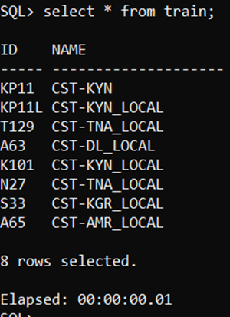

Slide 30
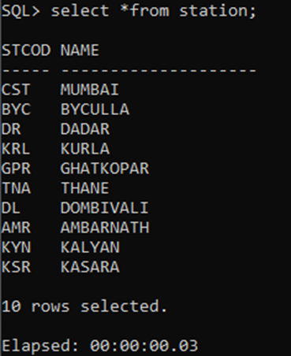
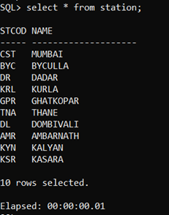

Slide 31
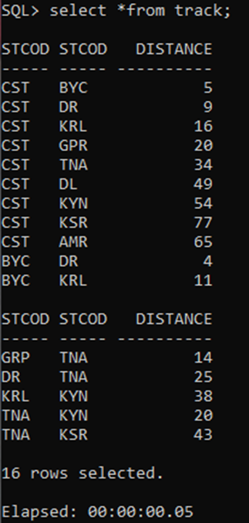
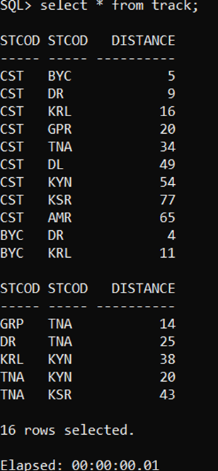

Slide 32
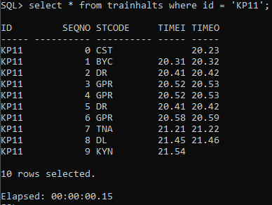
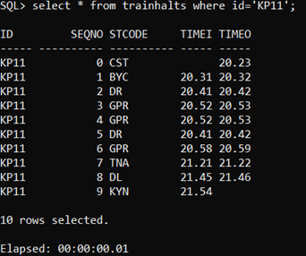

Slide 33
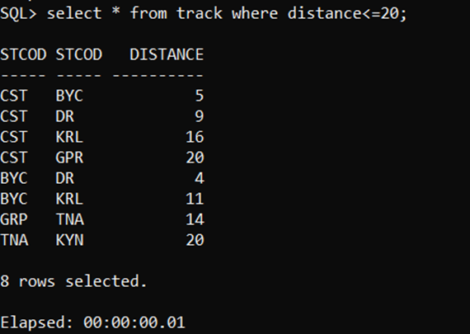
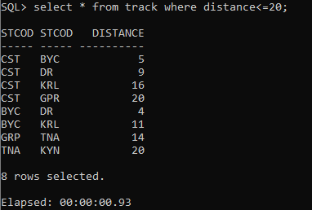

Slide 34
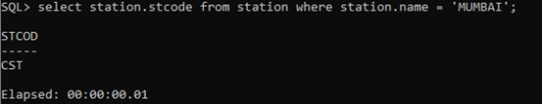
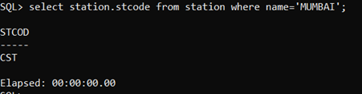

Slide 35
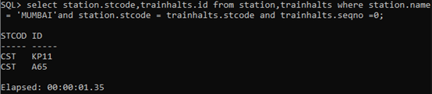
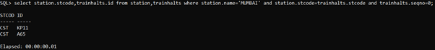

Slide 36
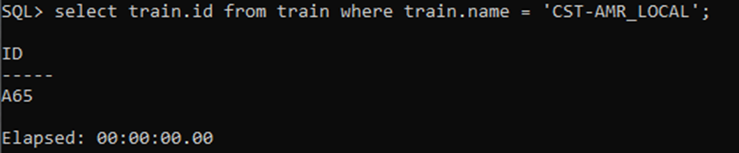
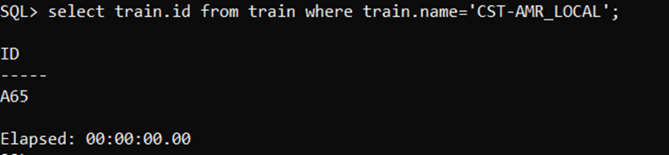

Slide 37
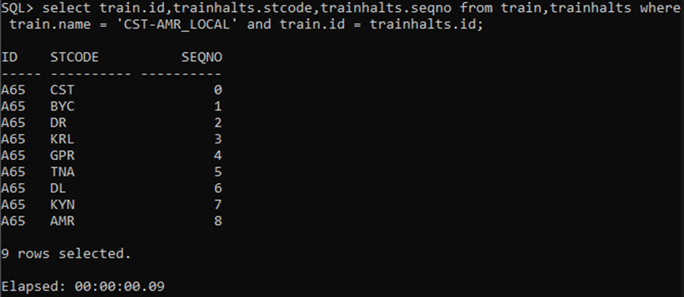
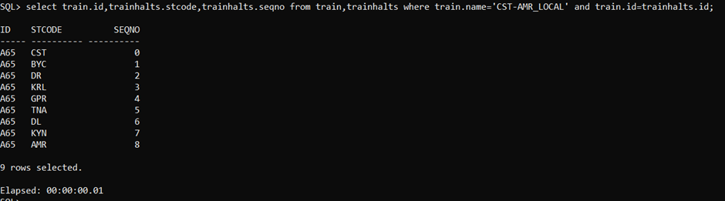

Slide 38
References
https://www.omnisci.com/technical-glossary/in-memory-database
https://paristech.com/blog/in-memory-data-advantages/#:~:text=II.-,Properties%20of%20In%2Dmemory%20Database%20Systems,multiple%20data%20transfer%20streamline%20processing
https://www.dataversity.net/in-memory-database-architecture-overview/#
https://www.tutorialspoint.com/sap_hana/in_memory_computing_engine.htm
https://devopedia.org/in-memory-database#qst-ans-6
Guided By: Arpita Shah

Slide 39



The Team
Nidhi Batra
Yash Bhalgamiya
Srishu Chintakindi

Slide 40

Thank You

